Slide 1
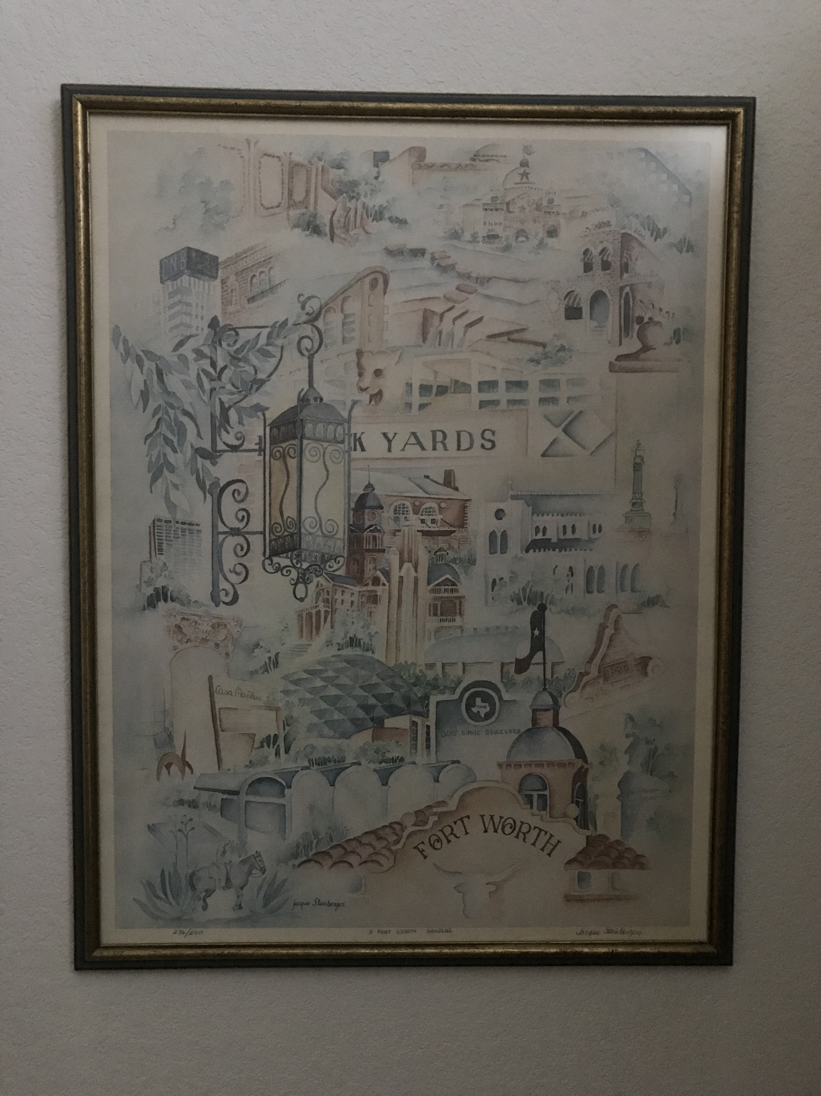
Accessibility in Communications
Meryl K. Evans
@MerylKEvans

Slide 2
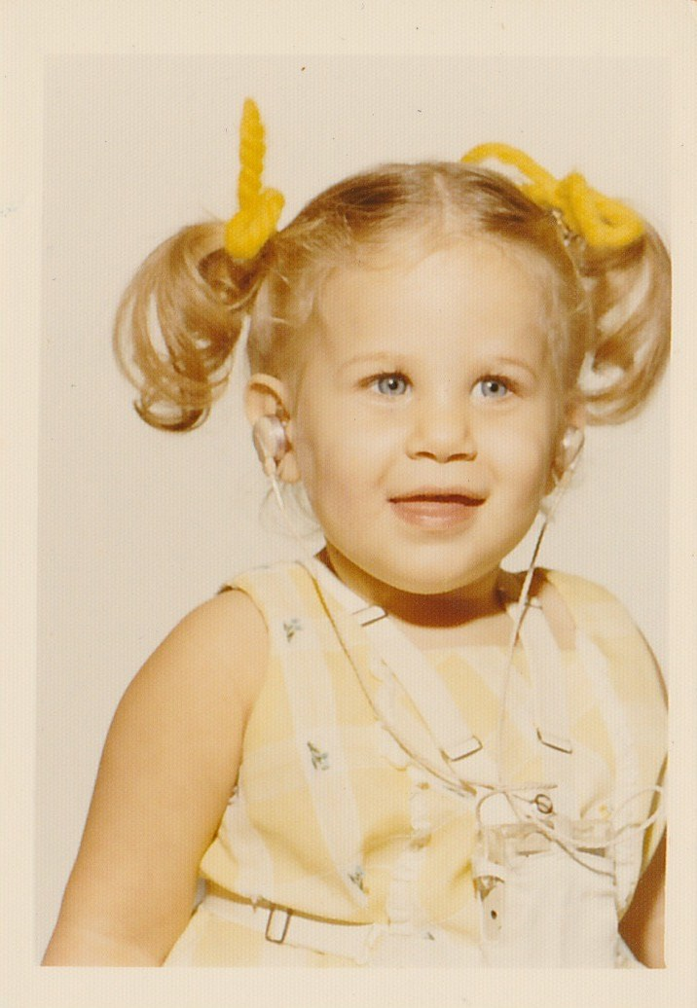
Howdy, I'm Meryl
She / her / deaf
Native Texan 🤠
Deaf since birth
Accessibility marketing

Slide 3
Assumptions
The problem with assumptions
Disability spectrum
Accessibility for all
Image credit: Pixabay

Slide 4
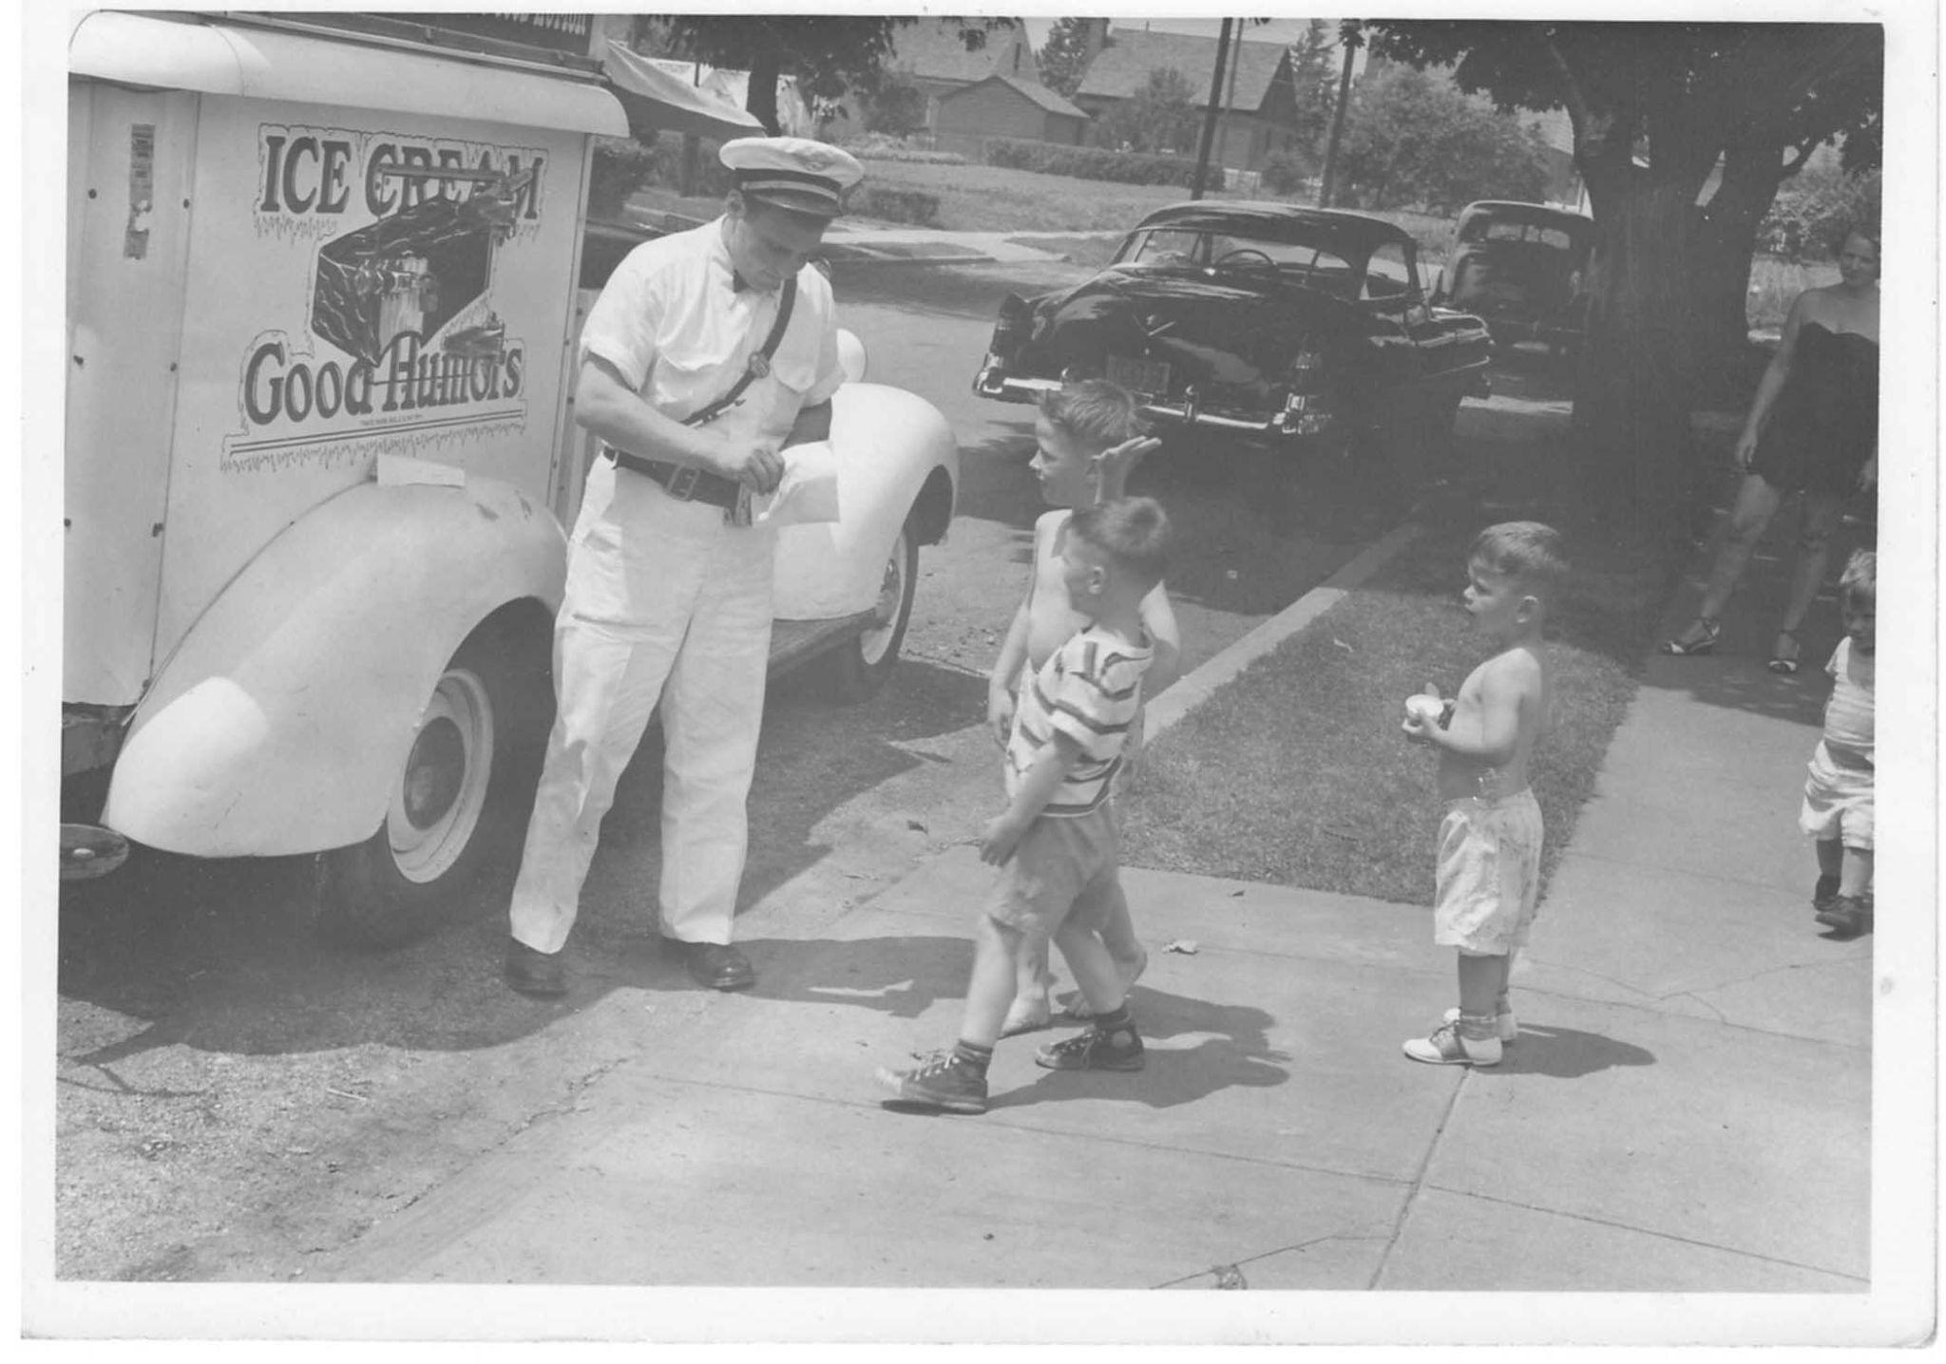
Curb-Cut Effect

Slide 5
Where to Begin with Accessibility
Publish information and deadlines
Ask
Turn on Zoom captions now
Create and grow checklists
Offer two communication options

Slide 6
Offer Two Communication Options
Digital
Chatbox
Email address
Online form (accessible)
Video: captions & interpreter
Chatbot
Physical

Slide 7
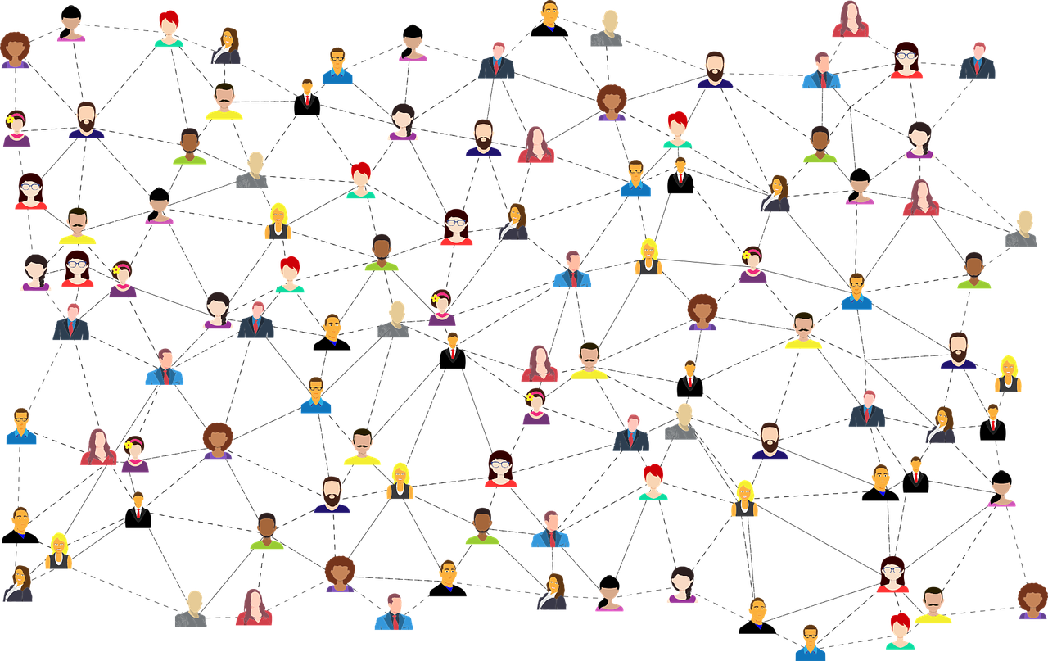
Accessibility is everyone's job.
Image source: Pixabay

Slide 8
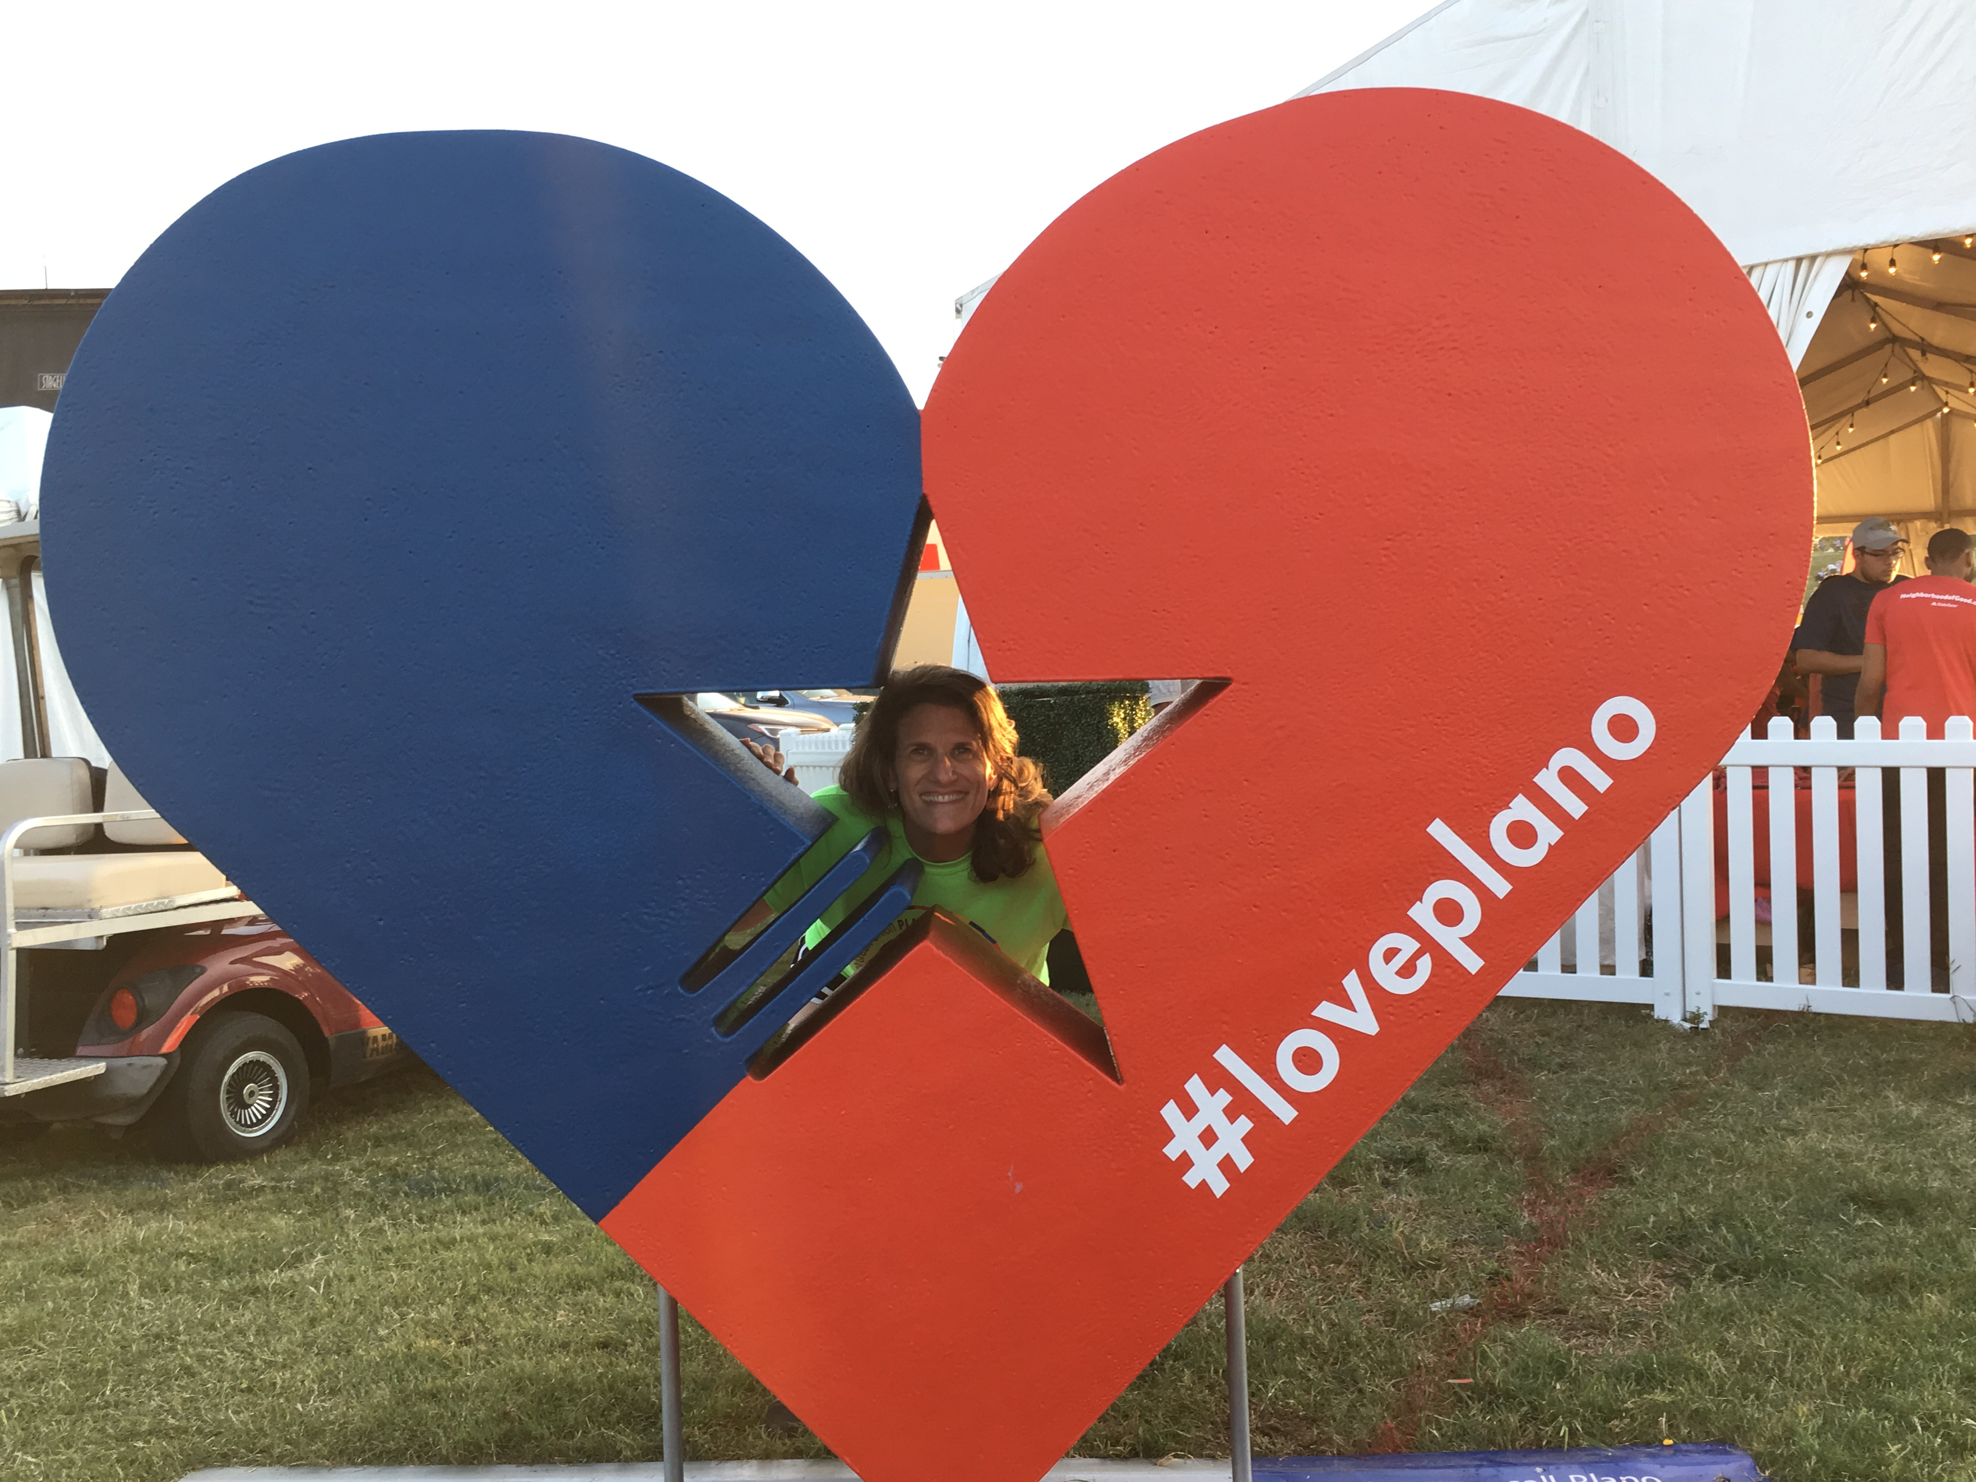
Contact
me@meryl.net
@MerylKEvans
Meryl.net

